Slide 1

Model-Driven development of IoT based Software
School of science and technologies
Degree in computer science (LM-18)
Student: Luca Marasca
ID n: 107104
Supervisor: Prof. Andrea Polini
Co-Supervisor: Dr. Fabrizio Fornari
Academic Year 2019/2020
Notes:
Hello everyone, my name is Luca Marasca and this is my master degree thesis . My Supervisor is Professor Andrea Polini and My Co-Supervisor is Doctor Fabrizio Fornari. My thesis title is Model Driven development of IoT based Software.

Slide 2


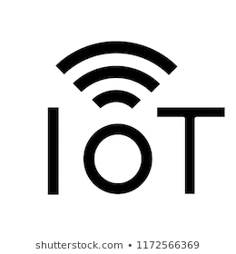
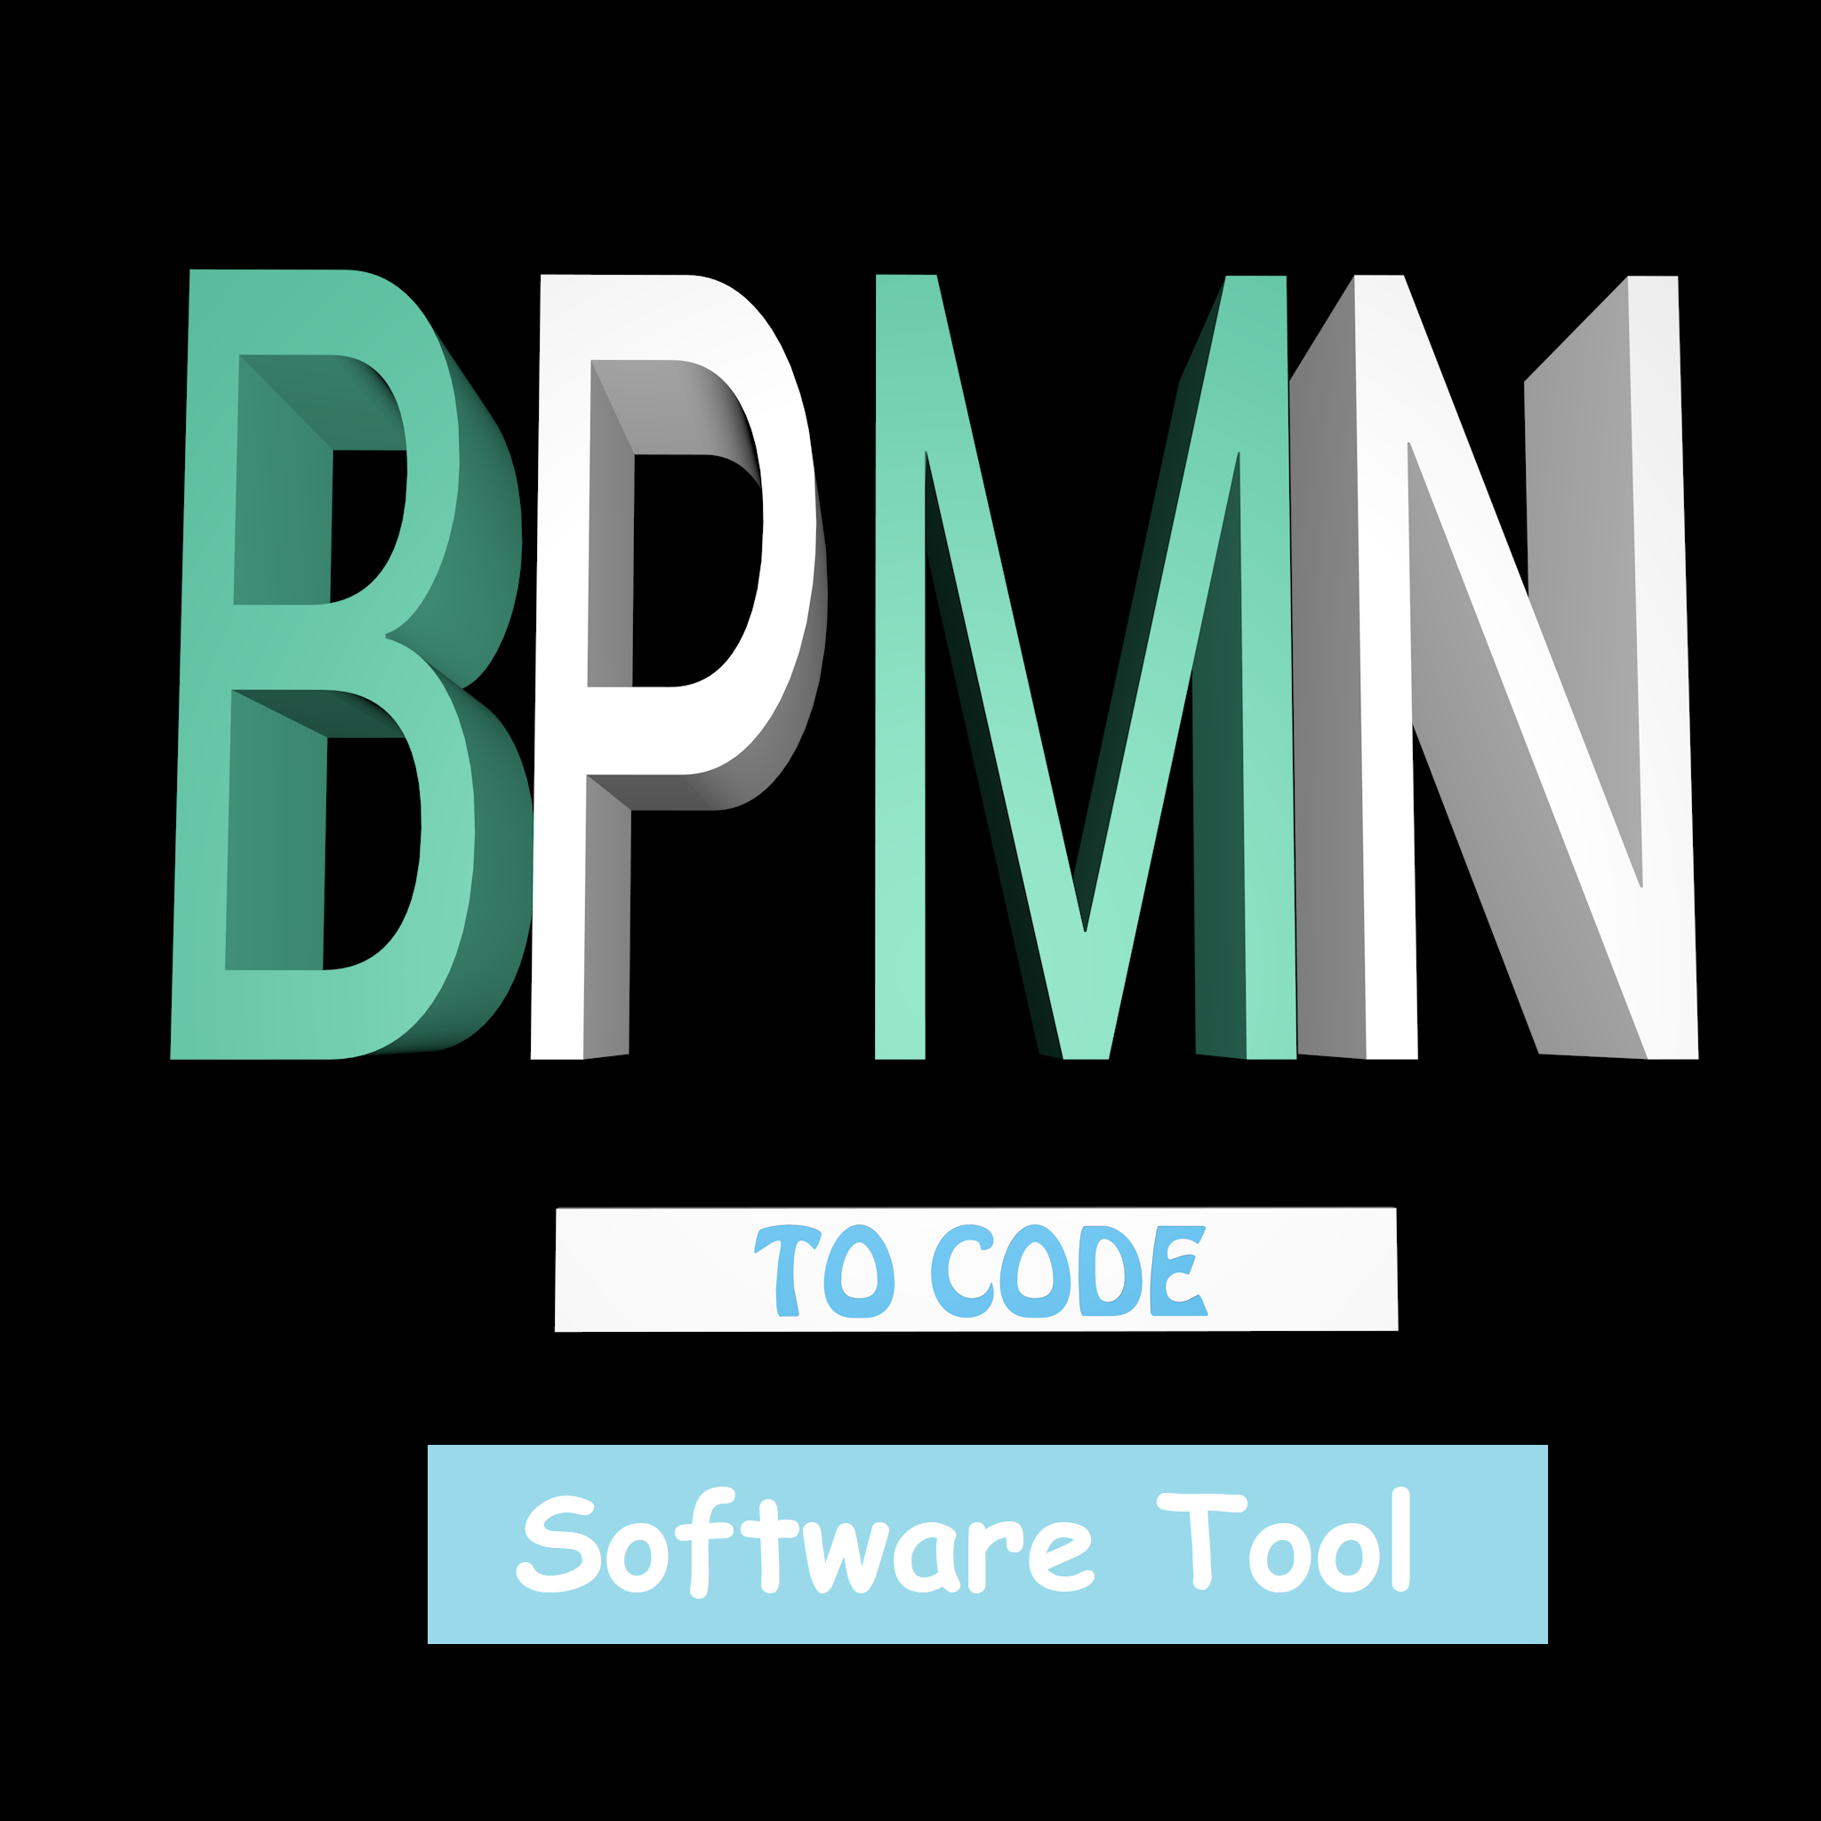

Project overview and objectives
Objectives: Definition of a framework based on Model Driven Engineering to drive business processes involving IoT devices + software tool.
The framework, “BPMN to code”, regards modelling and implementation.
Notes:
To introduce my work, i’ll firstly give you a rapid overview about my project.
The main objective of my thesis was the definition of a framework, easy to adopt, involving a model driven approach for representing IoT and a support tool that can be used for help the developers during the implementation phase. The work, provides then a set of techniques that can be adopted during the modeling phase for representing IoT devices in a BPMN and it also provides a compiler that will translate the defined model in code.
Adopting this framework, it’s possible to generate code for any number of devices, connected to any number of sensors and using any number of protocols. Of course with some limitations that i’ll explain later.
The framework, named “BPMN to code”, can be divided in activity, which are: Modeling, Configuration and translation.

Slide 3
Traditional Approach Main Problems
Project Analyst/Developer→ Produce the Model
Software Developers→ Implements the Tasks
No standard way to represents IoT devices in high-level models.
Implementation deviates from the intentions and expectation of the Business Analyst.
Changing in the model business process part concerning IoT necessitates the adaption or recreation of the implementation.
Notes:
But why is this framework useful? why do we need it?
Because what use to happen in the traditional approach it’s the fact that the project analyst will produce the model and after that, the software developers will produce works based on it. This kind of approach by the way has some issues:
First of all, there’s not a standard way for represent IoT in BPMN, since, BPMN is an high level overview of the business process, meanwhile IoT are almost physical.
The second problem is that, since the model can easily be misunderstood by the programmer, the implementation could deviates from the intentions and expectations of the business analyst.
Another problem, at least, it’s the fact that changing the model part regarding the IoT, during the implementation phase, could means the manual adaption or intere recreation of the code.

Slide 4
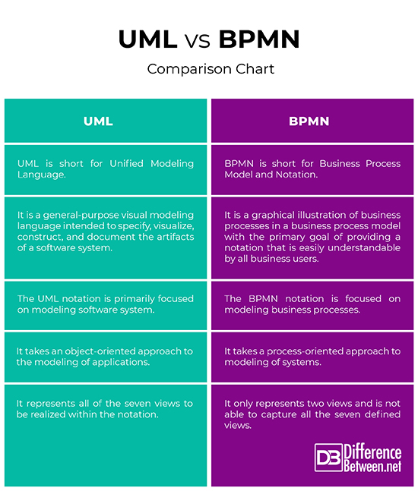
Study of the Literature
Which model?
How to generate code?
Notes:
Of course, all the work born from a carefully study of the literature. In this sense a lot of solutions for solving this issues has been taken in exam, starting from the model choice until the code generation.
For what concern the model, the choice was between different model diagram, but since the idea, was to move in direction of the business analyst, the final choice has been BPMN.
In the same way, for what concern the code generation, the approaches taken in exam has been a lot, starting from the idea to add another model concerning the IoT information, but since, the framework has to be easy to use, the idea has been to add somehow information without adding an external schemas.

Slide 5
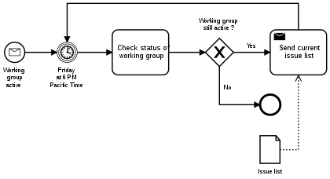

Modeling
Business Process Model and Notation (BPMN) is a standard for business process modeling that provides a graphical notation for specifying business processes in a Business Process Diagram (BPD), based on a flowcharting technique.
Notes:
For what concerns the modeling phase, The modelling notation taken in exam is the Business Process Model Notation (in short BPMN).
Business Process Model and Notation (BPMN) is a standard for business process modeling that provides a graphical notation for specifying business processes in a Business Process Diagram (BPD), based on a flowcharting technique. BPMN has been designed to provide a standard notation readily understandable by all business stakeholders, typically including business analysts, technical developers and business managers.
For representing the BPMN the software used has been Camunda, which is an Open source platform for BPMN workflow and DNM decision automation.

Slide 6

Modeling
How to represent IoT in BPMN
There’s the necessity of closing the gap between BPMN and IoT
Two main family of approaches:
BPMN + extensions
BPMN standard
How?
Use of subtasks
Represent IoT in a separate BPMN diagram
Use BPMN in a not standard way
Notes:
Still remaining into the modeling layer, another thing to take in exam it’s the IoT representation. For doing it, two main families of approaches has been taken in exam: in particular the first family of approaches, consist of representing the low-level information using an extension; but since, the work, intend to give something easy to use, the possible solutions have been taken in relation of the second families of approaches, so, the framework will not use extensions.
The possible solution proposed are those three:
The first method for representing the IoT consists of using subtasks, in which the flow regarding the IoT will be inserted. In the same way, another solution that still works consists of represent the IoT BPMN in a separate diagram that could be connected to the main one using for example a call activity.
The last method still works, but it’s not recommended, since it violates the theoretical usage of the BPMN. This approach consist in fact on defining the IoT information on the same level of abstraction of the main BPMN.

Slide 7

Configuration
Configuration Language
Why do we need a configuration language?
Language structure?
Keyword : value
Keyword = value
Keyword
{
Keyword1 = value1
Keyword2 = value2
}
Notes:
Since in the Business Process Modeling and Notation, the information are represented in an high level point of view, the code generation concerning IoT would have been impossible without inserting additional information into the diagram. For this reason a Configuration its needed and for this purpose the proposed solution adopt a configuration language that can be used for specify the low-level information required.
The language structure is composed by a list of couple, keywords-value separated by the equals symbol (``='') or the colon (:) and moreover the main keywords type that are composed by multiple values has recursively inside them a couple list with the form just explained enclosed into curly brackets.

Slide 8


Configuration
Language Usage
Manage the flow of code
What it’s intended to do in a task:
15 <= TEMPERATURE [LOWTEMP , 2]
_TASK{
DEVICE : "arduino"
NAMEID : "LOWTEMP"
TEMPERATURE{
NAME = "TMP36"
PINS = "0"
SENSOR_ID = "2"
}
}
Notes:
With the configuration language it’s possible to specify what it’s intended to do in a specific task concerning the IoT, in the first picture it’s shown the configuration of a task in which it’s intended to use an Arduino, which has ID equals to low temp and that reads data from a TMP36 temperature sensor connected to the Pin 0 which has ID equals to 2.
The configuration language can also be used for specify information for managing the flow of the code. In this sense, it’s possible to specify condition expression that has the form showed in the second picture. The expression can be specified following the syntax of a programming language like java. If it’s intended to adopt sensor information, there’s the necessity of writing a keyword, followed by additional information that has to be inserted into square brackets. Those informations, are the device ID and In case for example the condition will take in exam a particular value given by a sensor, the sensor ID.

Slide 9


Translation
BPMN To Code Software Tool
Reduce misunderstanding.
Create a first structure of the code or the intere code.
Reduce significantly the product implementation duration.
The BPMN needs to be structured as the framework implies.
Xtext -> Is a framework for building language workbenches for textual domain-specific languages
Xtend -> is a statically-typed-programming language built with Xtext and compiled to Java.
Notes:
As explained before, for the translation the framework provides a software that will take as input the XML of a BPMN and will produce as output the IoT Compatible Code. This tool, it’s based on java , and use Xtext and Xtend, for compiling the input information and produce code.
In particular, Xtext is a framework for building language workbenches for textual domain-specific languages. and Xtend is a statically-typed-programming language built with Xtext and compiled to Java.
The Translation phase, can be divided again into sub parts, that are the reading and analysis of the data, the managing of the information and the code generation. For adopting this tool of course, the BPMN has to be modeled using the framework phases explained above.

Slide 10
Grammar Definition
Why?
Allow the software to interact with the XML
Allow the software to interact with the configuration language
Parse tree generation
Code correctness
How does it works?
Grammar structure
Notes:
Let’s start from the first sub part: For the reading of the data, the best solution in this case is the usage of a Grammar, that will allow to interact with the XML and the configuration language. In particular, this choose has been made because it allow me to define rules that can be used for checking the correctness of the information .

Slide 11
XML Grammar
Model:
model += Xml
;
Xml:
{Xml} prolog? elements+=element*
;
prolog:
"<?" HEAD "version=" STRING "encoding="STRING "?>"
;
element: (open += Open
contents+=content close_tag+=Close)
| singleton_tag+=Singleton
;
Notes:
Let’s analyze in detail the main part of the grammar used to interact with a BPMN.
The grammar starts from the rule Model, which specify that the grammar it’s made by a list of XML rules.
An XML rule, at the same time, it’s composed by a prolog which is the intestation of the xml file and from a set of elements.
The elements could be in a logical line of reasoning of three types, which are: Open tag, contents which is the content of an open tag, or for better explain it, in a parsee tree the contents are the son of an open tag; The close tag and at least the singleton tag.

Slide 12
XML Grammar
content:
{content}
( type += ("_TASK") "{" codex += codex "}"| element+=element | body+=preconditions* body+=(BODY |variables) body+= conditions* | keywords+=KEYWORDS | data+=STRING)*;
Open:
("<" head+= HEAD ":" keywords += KEYWORDS ((head1 += HEAD ":") | ((head1 += HEAD|keywords1 += KEYWORDS) "=" value+=STRING))* ">")
;
Singleton:
{Singleton} ("<" HEAD ":" keywords+=KEYWORDS ((HEAD ":") | (keywords1+= KEYWORDS "=" value+=STRING))*) "/>";
Close:
{Close} ("</" HEAD ":" KEYWORDS ">")
;
Notes:
For better understanding the type of tag, in this slide are represented all of them. In particular HEAD and KEYWORDS are terminal symbols which consist of all the possible words that can appear into the Camunda’s XML.
If you look at the tag content by the way, you will see that a possible content could be “TASK”, infact, this part of the rule is used for connect the configuration language to the BPMN XML.

Slide 13
Configuration Language Grammar
codex:
( device_code += device protocol += protocol* sensor_code += sensor* ) ;
device:
"DEVICE" ":" device += STRING
"NAMEID" ":" id += STRING;
protocol:
((pname += ("MQTT") ) "{" (mqtt_data += mqtt_data mqtt_device += protocol_device) "}") |
((pname += ("HTTP") ) "{" (http_data += http_data http_device += protocol_device) "}");
sensor:
(sname += "TEMPERATURE" "{" sensor += sensor_data "}")|
(sname += "DISTANCE" "{" sensor += sensor_data "}")|
(sname += "GAS" "{" sensor += sensor_data "}")|
(sname += "LIGHT" "{" sensor += sensor_data "}")|
(sname += "LED" "{" sensor += sensor_data "}");
Notes:
In this slide it’s shown the main part of the Configuration Language grammar, in particular, into the codex, it’s needed to be specified, a device and then, if present, one or more network protocols and one or more sensors. For what concern the device, the needed informations are the device name and the device ID, where the device ID it’s used for specify a particular device or a family of devices. Regarding the protocol and the sensor, the information required have the same form of the rest of the language configuration

Slide 14
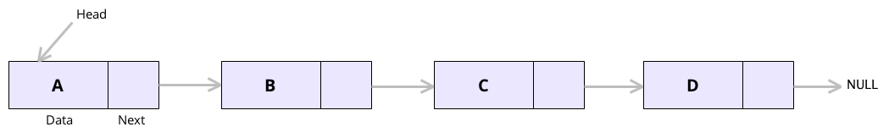
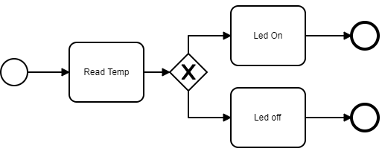
Translation - Convert BPMN to code
Phase 1: Define a compiling order base case
Problem? The input information doesn’t have an order.
Notes:
The second phase of the code translation it’s the managing of the data taken as input.
An interesting problem about this part is given by the fact that the xml taken in input is not in order, and as consequence the information into the parse tree are not in order too, the idea than it’s to create a list of elements that act as translation order.
In this sense, it’s possible to see a BPMN as a list, where the tasks are the node of the list and the arrows are the pointer that connect the node.
The proposed algorithm, will use a recursive approach, exploring every possible successors of an element and inserting it into the list, so for what concern this simple BPMN showed into the slide, into the list will be inserted the information following the order: read temp, condition1, led on, condition 2, Led off.

Slide 15
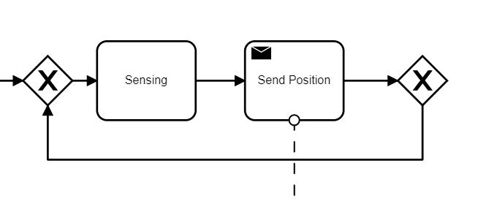
Loop Managing
Solutions?
Temporary arraylist
If an elements is repeated -> loop
If the process ends -> remove elements until the beginning of the arraylist or until the last diramation.
Notes:
In case there’s a presence of a loop into the diagram, the software applies a particular algorithm, which consist of:
Create a temporary arraylist, in which are inserted the elements in the same way of the translation order.
After that:
If an element it’s repeated, this means that there’s a loop.
If the sequence ends, all the element starting from the end until beginning of the business process or until the last not explored condition are removed from the arraylist.

Slide 16
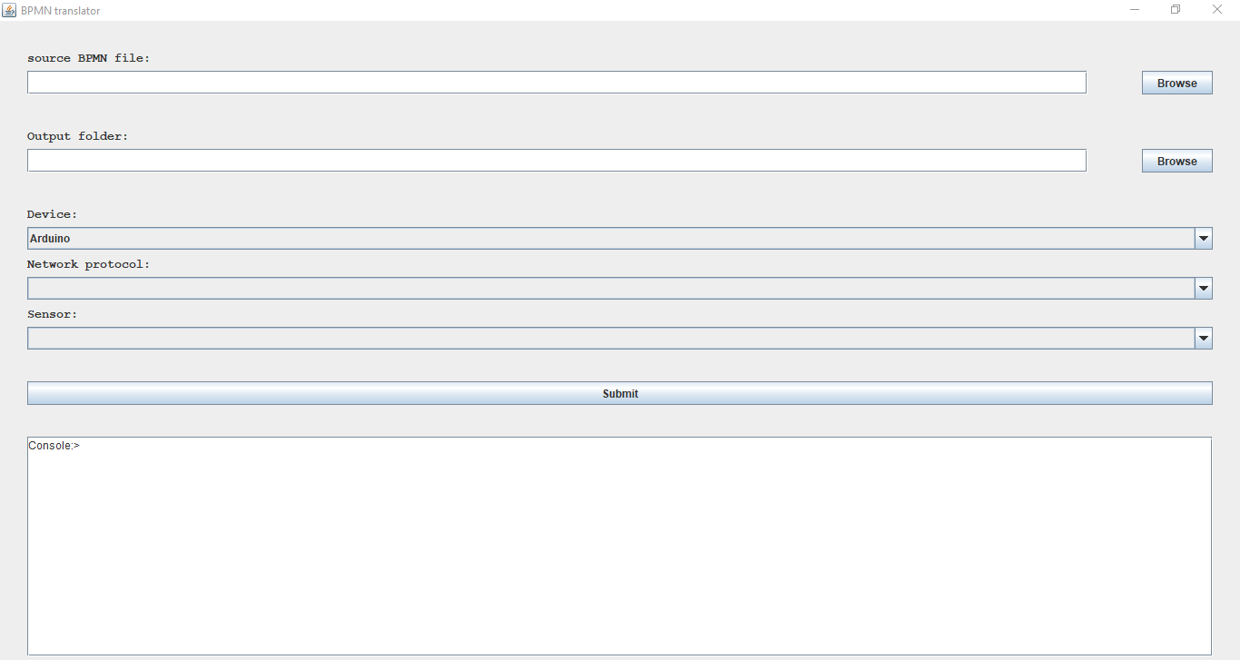
Code Generation & software usage
The last step is the code generation.
One file for every device + one library.
Notes:
For what concern the generated code, the result it’s a main file for every single device and a library that can be used by all the devices.
The software tool, usage it’s pretty simple: it’s just needed to select as input the dot translator file containing the BPMN XML, select an output and confirm. The dot translator extension it’s an extension that i’ve defined by my own .
In case no BPMN has been provided there’s also the possibility to select manually a sensor and a network protocol for a device, and the software will generate libraries in relation of the choosen made. In the last part of the GEE-YOU-EYE, there’s a console in which are reported all the message that can be provided by the software.

Slide 17
Compatible devices and limitations
Sensors:
Led diode
Temperature
DHT11
DHT22
TEMP36
Gas
MQ9
Light
LM358
Distance
HC-SR04
HY-SRF05
Shields:
ESP32
ESP8266
MKR1010
W5100
Limitations:
Compatibility with the sensor listed
Configuration language limit
BPMN event managing
Network Protocols:
MQTT
HTTP
Devices:
Arduino
Notes:
In the left part of the slide are reported the possible sensors, shield, network protocols and devices that can be used.
As said at the beginning of the presentation, the software tools present some limitations that are:
The fact that the software tool it’s compatible with just the sensor listed in the slide
The configuration language limitation, in the sense that, you can not produce any type of code, but you can just use the keywords defined in the grammar, and for every keyword-value, some code will be generated.
The tool doesn’t support managing of events, so it’s not possible to write something for example in a callback or do something like this.

Slide 18
Demo

Slide 19
Conclusion
The goal has been reached
Future Developments
Code Optimization
Add new sensors, protocols and devices
Event managing
Increase Domain
Add a GUI for the configuration managing
Automatic translation of .bpmn files in .translator files

Slide 20
Thanks for the attention

